Slide 1

Think Green Investing
Fintech Bootcamp Program
April 20, 2022
Amany, Katharine, Nicolas

Slide 2

Agenda
Inspiration
Hypothesis
Key Project questions
Data Discovery and Analysis
Key Takeaways

Slide 3

Inspiration
Think Green Investing is a solution targeted to Environmentally conscious and/or ESG* Investors
Alternative sources of energy are key in the agenda for all countries to achieve emissions targets by 2030 and net zero by 2050
Canada: by 2050, Canadian Net-Zero Emissions Accountability Act
Area of focus to explore investing
Provide the context, the why?
*ESG: Environmental, Social, Governance

Slide 4




Hypothesis
Due to the commitments that the international community has made to tackle climate change and growing demand, industries in the Solar Energy sector have a higher potential to be more profitable in the long term
Think Green Investing offers investors a user-friendly solution to achieve higher-returns vs S&P500

Slide 5
Key Project Questions
What time frame should be assessed?
What performance indicators will allow to validate the Hypothesis?
What would be the benchmark of comparison ?
What companies will create the ideal portfolio?

Slide 6


Data Discovery
Sourcing
Exploration
Clean Up
5Y
2018-2022
Identified the companies, defined a function that pulls tickers daily closing prices in the given time period using alpaca trade API
Split:
War (Feb – Apr 2022)
COVID-19 (Jan’20 – Feb’22)
Pre-COVID-19 (Jan’18 – Dec’19)
Daily Returns
Cumulative Returns
STD Dev
Sharpe Ratios
Correlations
Notes:
Sourcing: Summarize how, and where, the data was found to answer these questions.
Exploration: Describe the data exploration and cleanup process
Clean Up: Describe the analysis process

Slide 7
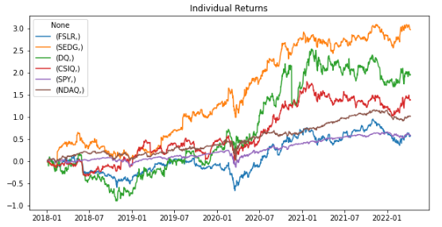
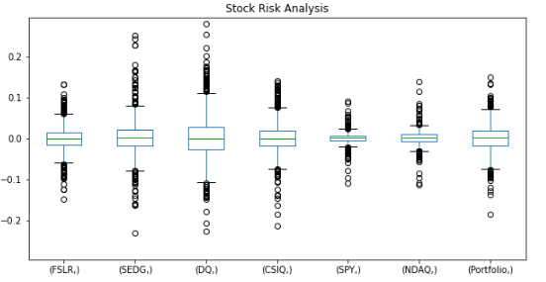
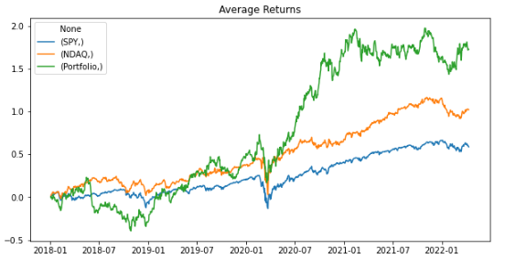
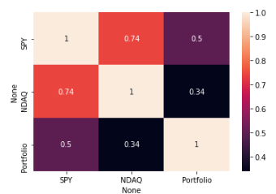
Analysis Snapshot 5Y Analysis
Sharpe Ratio: 0.50
Correlation

Slide 8
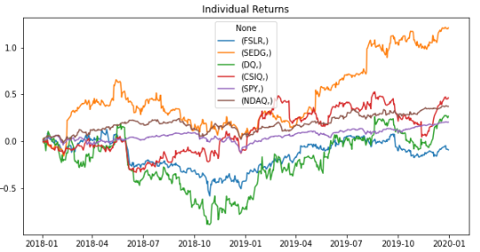
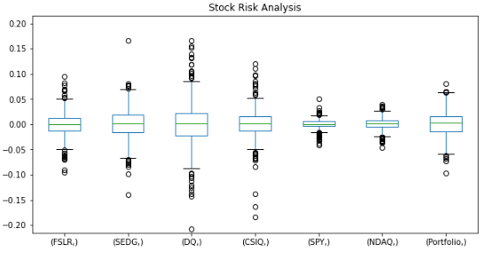
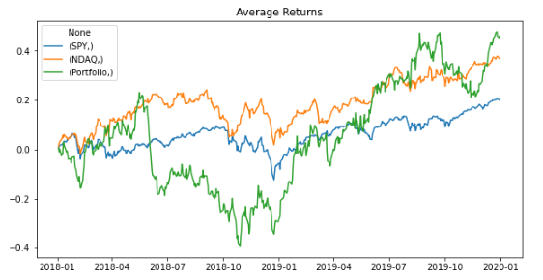
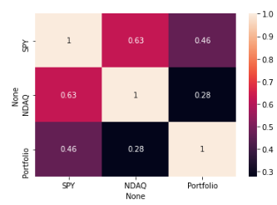
Analysis Snapshot Pre Covid-19
Sharpe Ratio: 0.33
Correlation

Slide 9
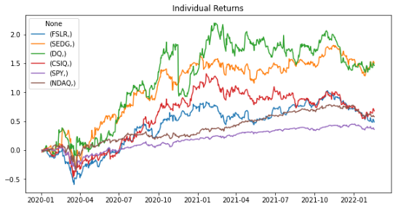
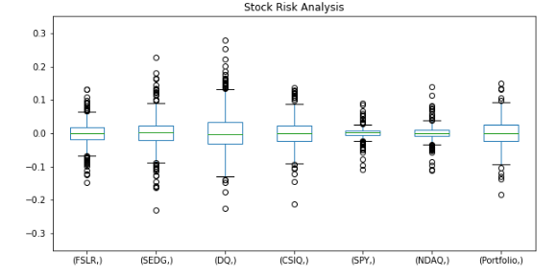
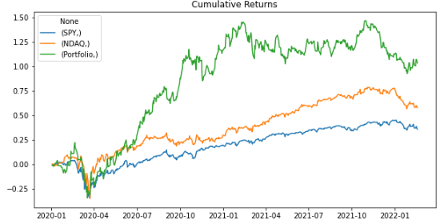
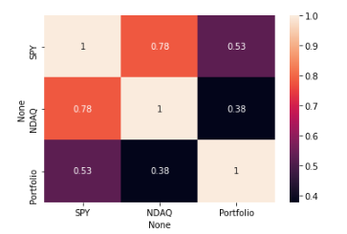
Analysis Snapshot Covid-19
Sharpe Ratio: 0.51
Correlation

Slide 10
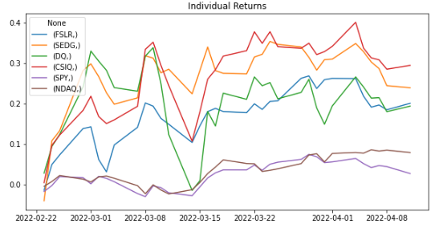
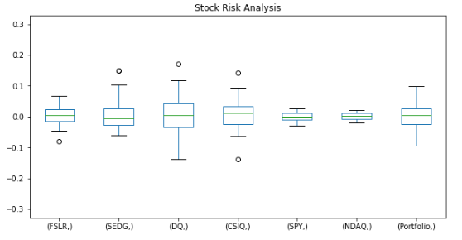
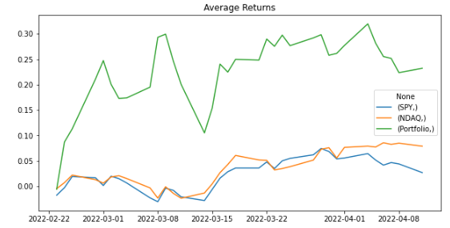
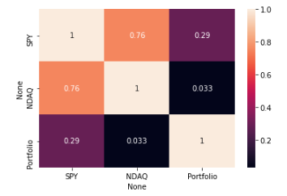
Analysis Snapshot Russia-Ukraine War
Sharpe Ratio: 2.13
Correlation

Slide 11






Key Takeaways
Solar Energy Stocks
Portfolio outperformed the market during all time frames analyzed
Pre-Covid-19
Steady growth from H2 2019, driven by SEDG – monitor closely
Volatility
Higher volatility than SPY and NASDAQ but more profitable with respect to risk
Covid-19 time
Accelerated growth following markets recovery post Q1’20 – all companies
Correlation
More correlation to SPY than NASDAQ – area to explore in next phase
Russia-Ukraine War time
Faster growth in correlation with increases of oil prices
Next Steps (Birthday Cake): Assess other benchmarks (e.g. Oil and Gas) and explore simulation models considering constraints

Slide 12
Additional References
Motley Fool:
https://www.fool.com/investing/stock-market/market-sectors/energy/renewable-energy-stocks/
https://www.fool.com/investing/stock-market/market-sectors/energy/solar-energy-stocks/
Investopedia:
https://www.investopedia.com/investing/top-solar-stocks/
Canada’s Achievements at COP26
https://www.canada.ca/en/services/environment/weather/climatechange/canada-international-action/un-climate-change-conference/cop26-summit/achievements-at-cop26.html
Others:
https://www.iea.org/reports/renewables-2020/covid-19-and-the-resilience-of-renewables

